Slide 1
CHAPTER 3 PROPERTIES OF PURE SUBSTANCES

Slide 2
Objectives
Introduce the concept of a pure substance.
Discuss the physics of phase-change processes.
Illustrate the P-v, T-v, and P-T property diagrams and P-v-T surfaces of pure substances.
Demonstrate the procedures for determining thermodynamic properties of pure substances from tables of property data.
Describe the hypothetical substance “ideal gas” and the ideal-gas equation of state.
Apply the ideal-gas equation of state in the solution of typical problems.
Introduce the compressibility factor, which accounts for the deviation of real gases from ideal-gas behavior.
Present some of the best-known equations of state.

Slide 3
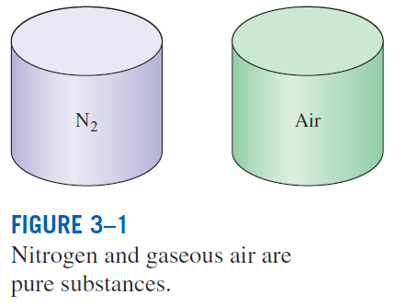
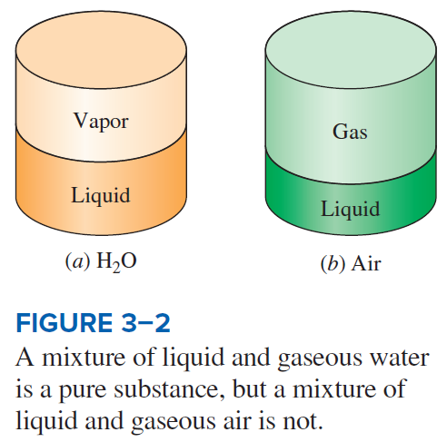
PURE SUBSTANCE
Pure substance: A substance that has a fixed chemical composition throughout.
Air is a mixture of several gases, but it is considered to be a pure substance.

Slide 4
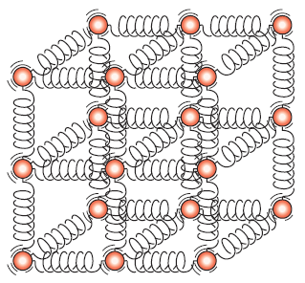
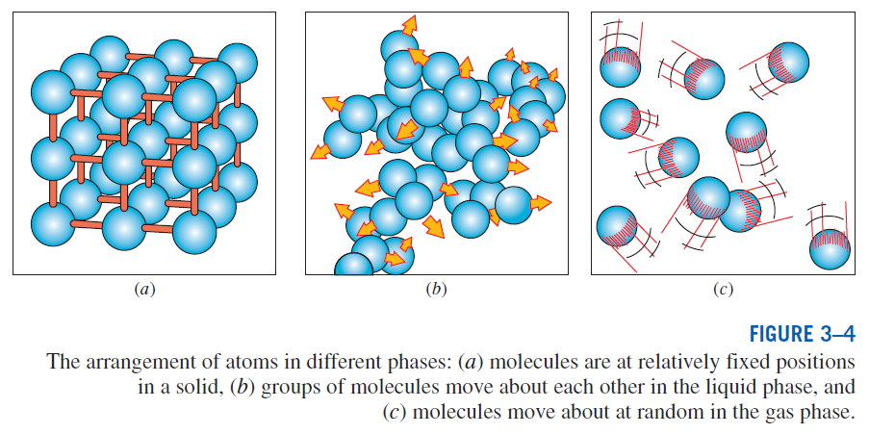
PHASES OF A PURE SUBSTANCE
The molecules in a solid are kept at their positions by the large springlike inter-molecular forces.

Slide 5
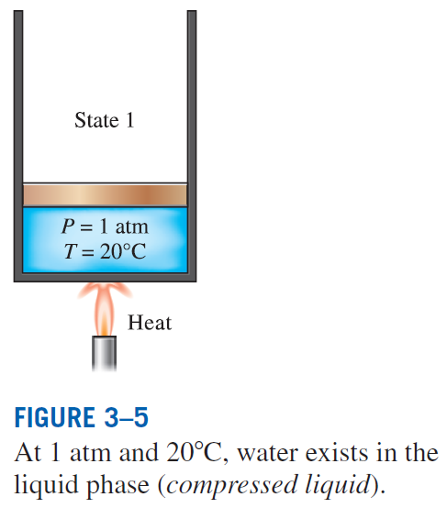
PHASE-CHANGE PROCESSES OF PURE SUBSTANCES
Compressed liquid (subcooled liquid):
A substance that it is not about to vaporize

Slide 6
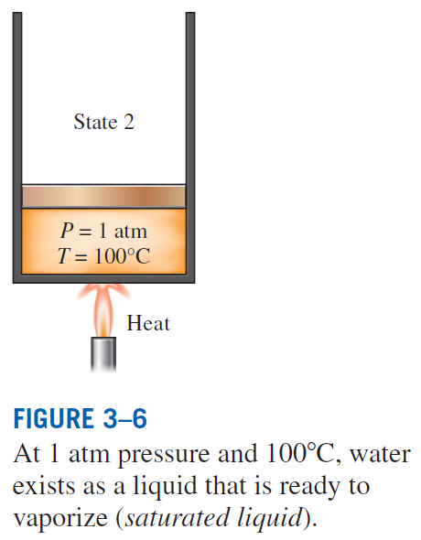
Saturated liquid: A liquid that is about to vaporize

Slide 7
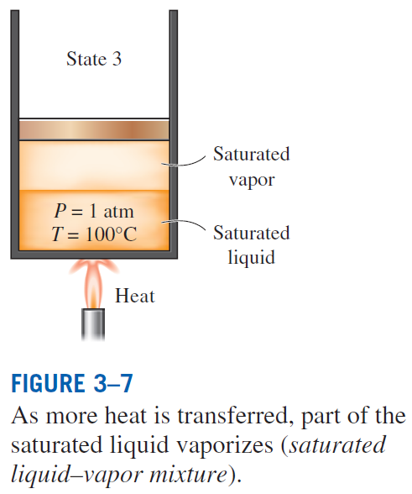
Saturated liquid–vapor mixture: The state at which the liquid and vapor phases coexist in equilibrium.

Slide 8
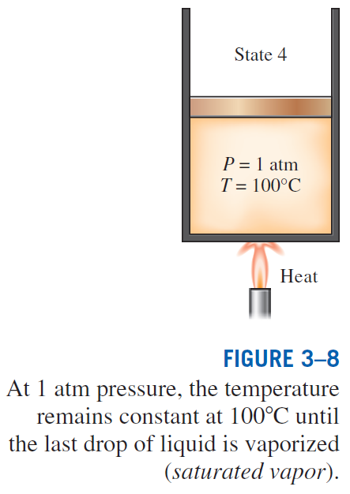
Saturated vapor: A vapor that is about to condense.

Slide 9
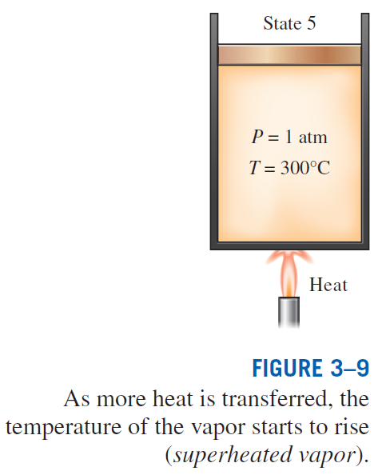
Superheated vapor: A vapor that is not about to condense (i.e., not a saturated vapor).

Slide 10
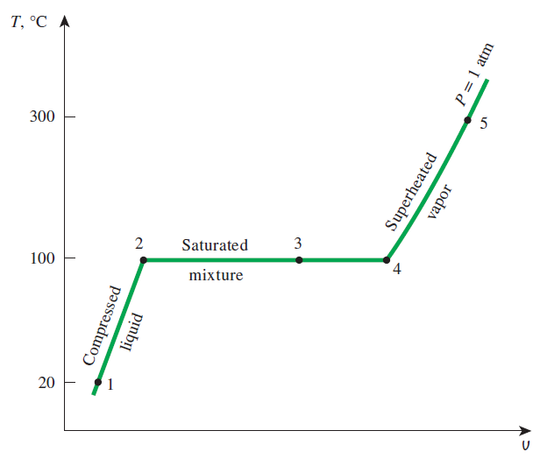
If the entire process between state 1 and 5 is reversed by cooling the water while maintaining the pressure at the same value, the water will go back to state 1, retracing the same path, and in so doing, the amount of heat released will exactly match the amount of heat added during the heating process.
T-v diagram for the heating process of water at constant pressure.

Slide 11
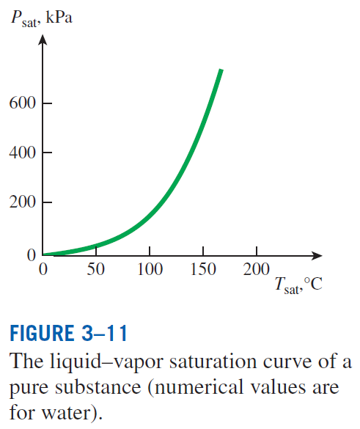
Saturation Temperature and Saturation Pressure
The temperature at which water starts boiling depends on the pressure; therefore, if the pressure is fixed, so is the boiling temperature.
Water boils at 100°C at 1 atm pressure.
Saturation temperature T_{sat}: The temperature at which a pure substance changes phase at a given pressure.
Saturation pressure P_{sat}: The pressure at which a pure substance changes phase at a given temperature.

Slide 12
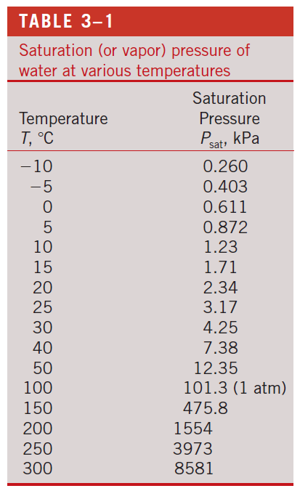

Slide 13
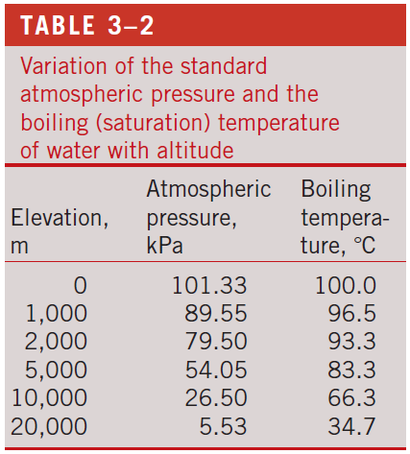
Latent heat: The amount of energy absorbed or released during a phase-change process.
Latent heat of fusion: The amount of energy absorbed during melting. It is equivalent to the amount of energy released during freezing.
Latent heat of vaporization: The amount of energy absorbed during vaporization and it is equivalent to the energy released during condensation.
The magnitudes of the latent heats depend on the temperature or pressure at which the phase change occurs.
At 1 atm pressure, the latent heat of fusion of water is 334 kJ/kg and the latent heat of vaporization is 2257 kJ/kg.
The atmospheric pressure, and thus the boiling temperature of water, decreases with elevation.

Slide 14
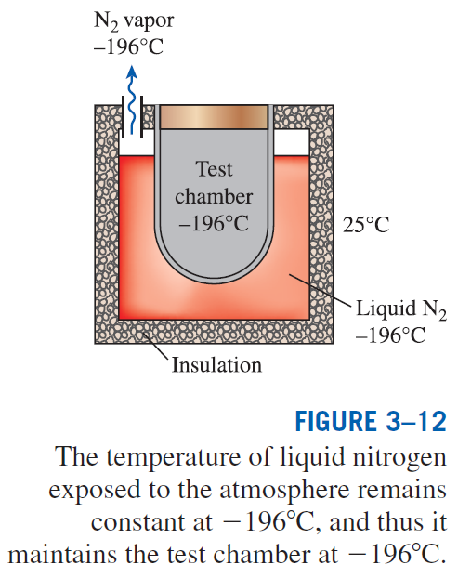
Some Consequences of T_{sat} and P_{sat} Dependence

Slide 15
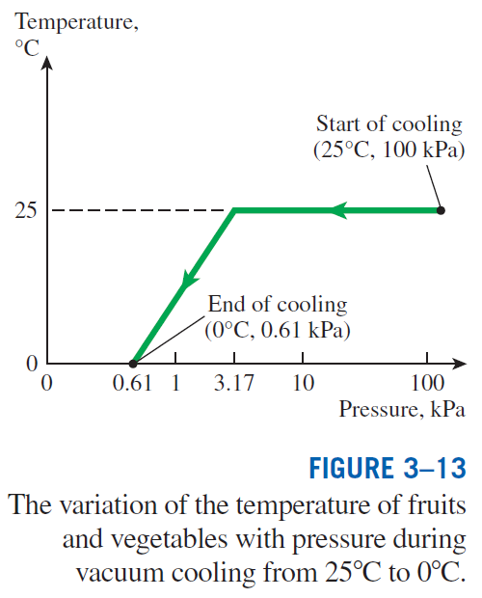

Slide 16
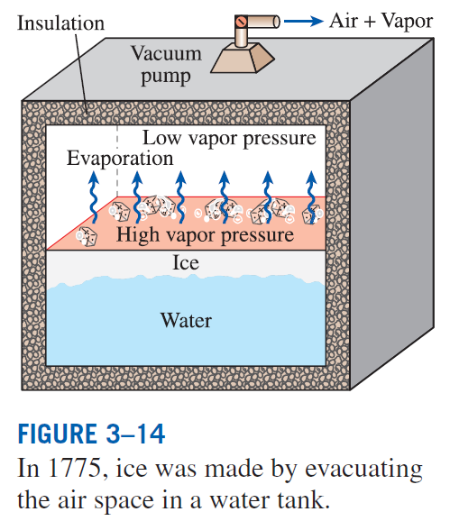

Slide 17
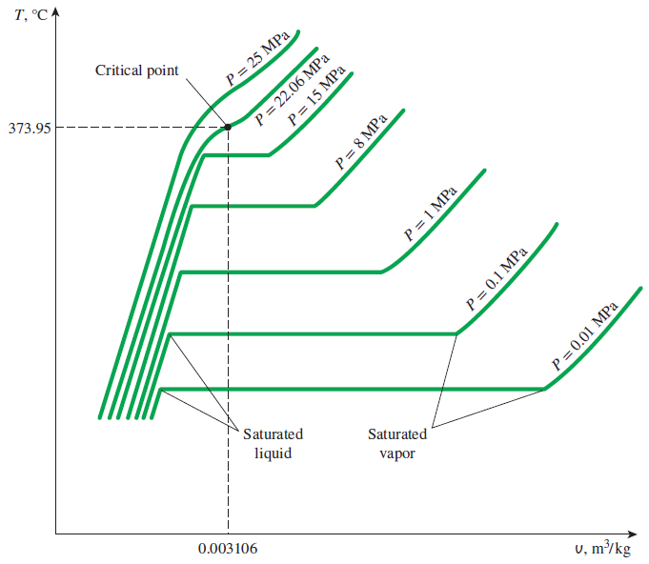
PROPERTY DIAGRAMS FOR PHASE-CHANGE PROCESSES
The variations of properties during phase-change processes are best studied and understood with the help of property diagrams such as the T-v, P-v, and P-T diagrams for pure substances.
T-v diagram of constant-pressure phase-change processes of a pure substance at various pressures (numerical values are for water).

Slide 18
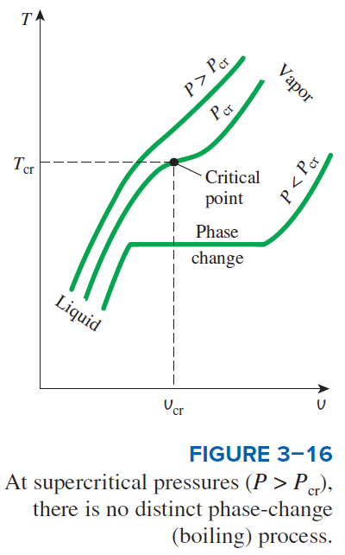
Critical point: The point at which the saturated liquid and saturated vapor states are identical.

Slide 19
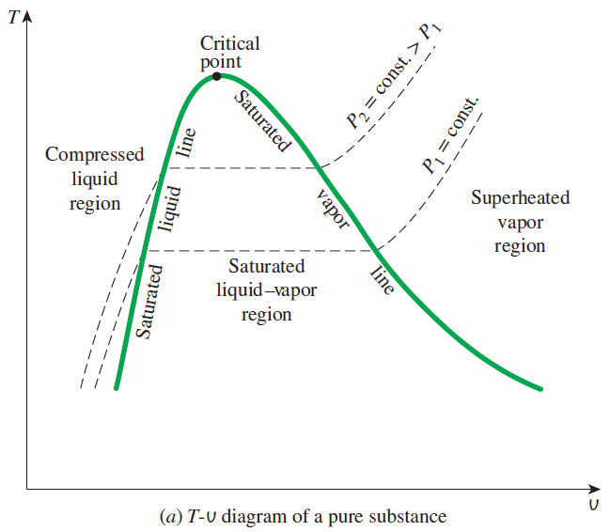
Saturated liquid line
Saturated vapor line
Compressed liquid region
Saturated liquid–vapor mixture region (wet region)
Superheated vapor region

Slide 20
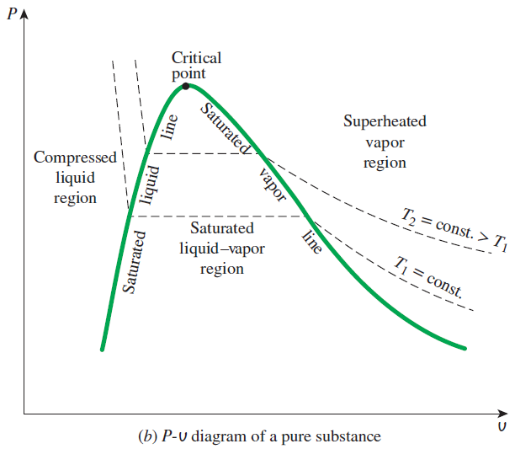
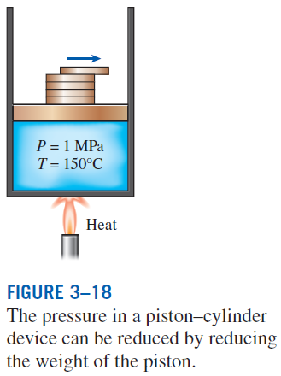

Slide 21
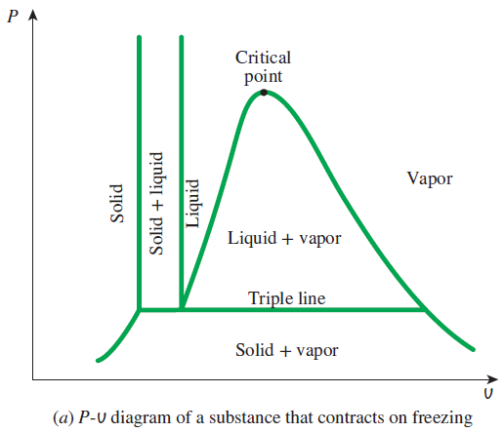
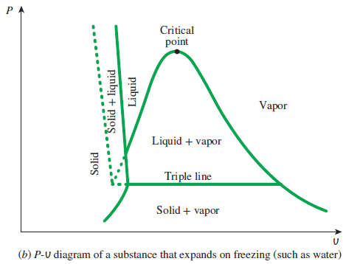
Extending the Diagrams to Include the Solid Phase

Slide 22
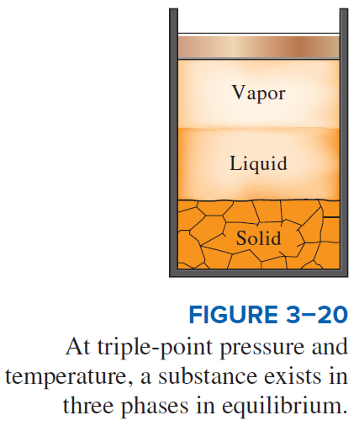
For water,
T_{tp} = 0.01°C
P_{tp} = 0.6117 kPa

Slide 23
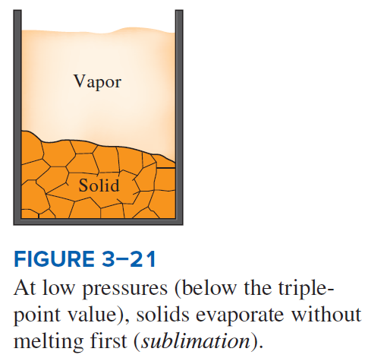
Sublimation: Passing from the solid phase directly into the vapor phase.

Slide 24
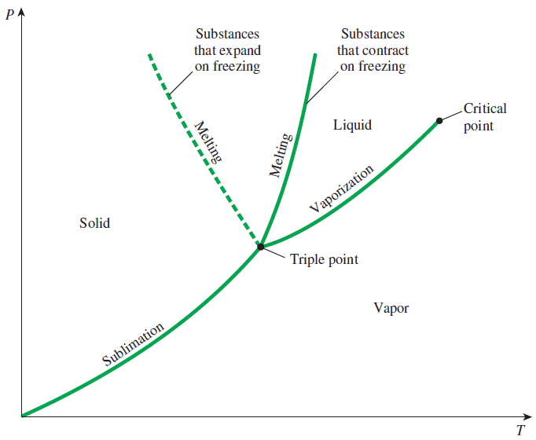
Phase Diagram
P-T diagram of pure substances.

Slide 25
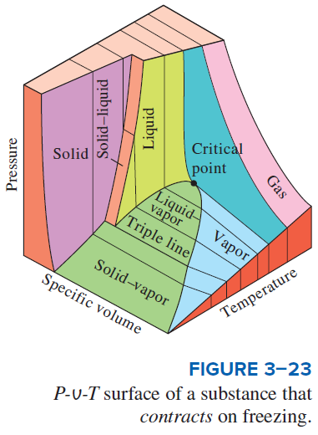
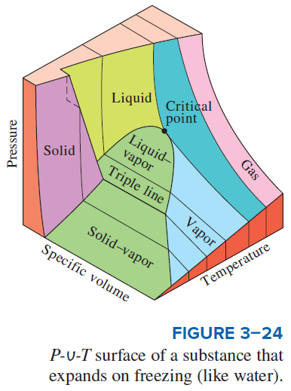
The P-v-T surfaces present a great deal of information at once, but in a thermodynamic analysis it is more convenient to work with two-dimensional diagrams, such as the P-v and T-v diagrams.

Slide 26
PROPERTY TABLES
For most substances, the relationships among thermodynamic properties are too complex to be expressed by simple equations.
Therefore, properties are frequently presented in the form of tables.
Some thermodynamic properties can be measured easily, but others cannot and are calculated by using the relations between them and measurable properties.
The results of these measurements and calculations are presented in tables in a convenient format.

Slide 27
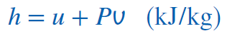
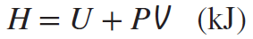
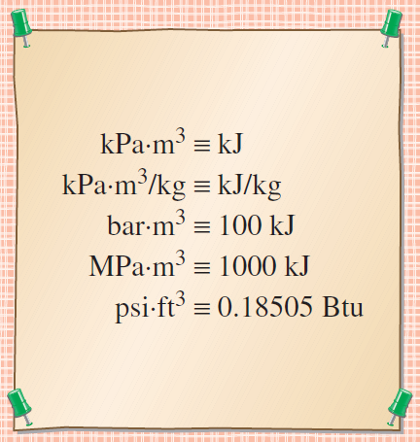
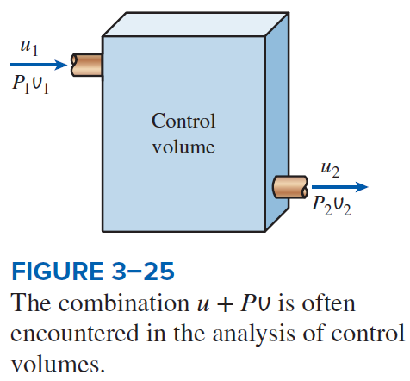
Enthalpy—A Combination Property
The product pressure × volume has energy units.

Slide 28
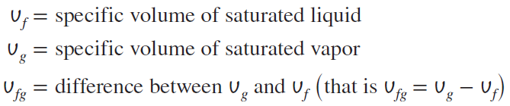
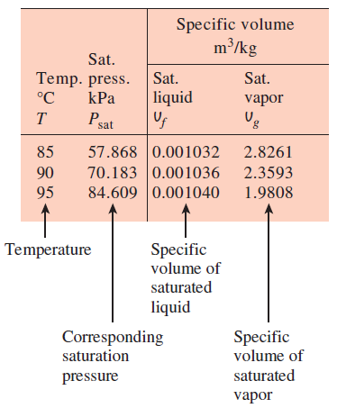
Saturated Liquid and Saturated Vapor States
A partial list of Table A–4.
Table A–4: Saturation properties of water under temperature.
Table A–5: Saturation properties of water under pressure.

Slide 29
Enthalpy of vaporization, (Latent heat of vaporization) h_{fg}
The amount of energy needed to vaporize a unit mass of saturated liquid at a given temperature or pressure.
It represents the amount of energy needed to vaporize a unit mass of saturated liquid at a given temperature or pressure.
It decreases as the temperature or pressure increases and becomes zero at the critical point.

Slide 30
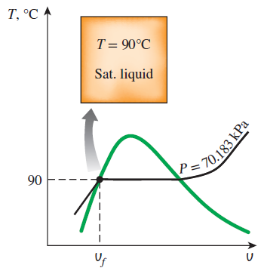
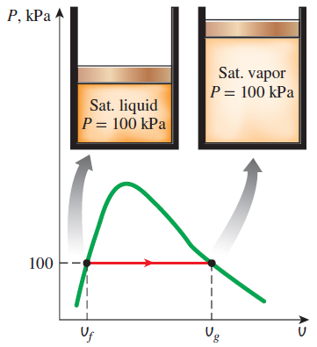
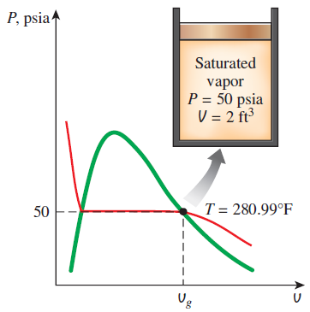
Examples: Saturated liquid and saturated vapor states of water on T-v and P-v diagrams.

Slide 31
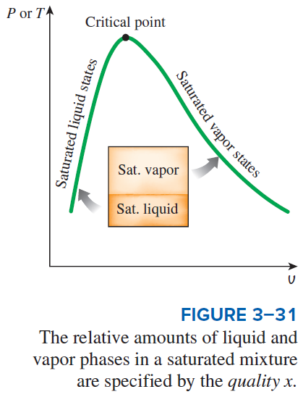
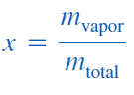
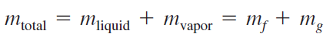
Saturated Liquid–Vapor Mixture
Quality, x : The ratio of the mass of vapor to the total mass of the mixture.
Quality is between 0 and 1
0: sat. liquid, 1: sat. vapor.
The properties of the saturated liquid are the same whether it exists alone or in a mixture with saturated vapor.
Temperature and pressure are dependent properties for a mixture.

Slide 32
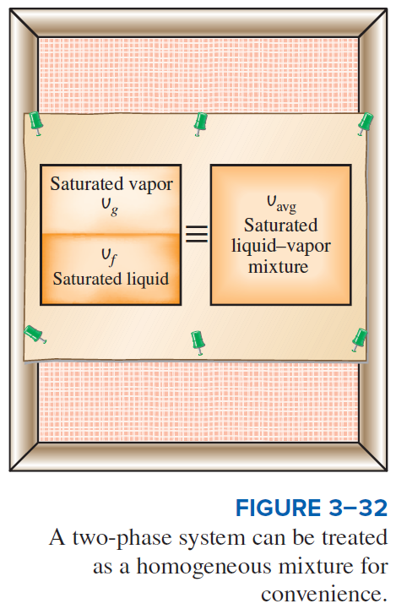

Slide 33
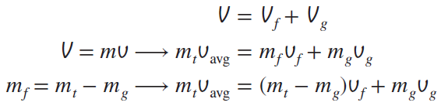
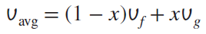
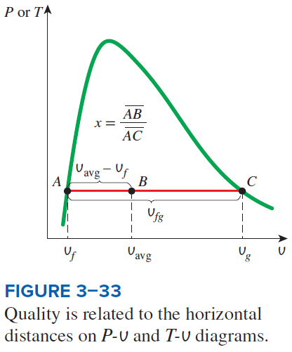
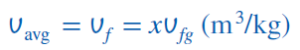
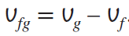
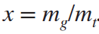
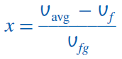
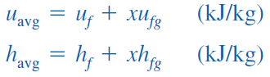
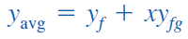

y v, u, or h

Slide 34


Slide 35


Examples: Saturated liquid-vapor mixture states on T-v and P-v diagrams.

Slide 36


Superheated Vapor
Compared to saturated vapor, superheated vapor is characterized by
In the region to the right of the saturated vapor line and at temperatures above the critical point temperature, a substance exists as superheated vapor.
In this region, temperature and pressure are independent properties.

Slide 37


Slide 38




Compressed Liquid
Compressed liquid is characterized by
The compressed liquid properties depend on temperature much more strongly than they do on pressure.
y → v, u, or h
A more accurate relation for h

Slide 39


Slide 40


Slide 41
Reference State and Reference Values
The values of u, h, and s cannot be measured directly, and they are calculated from measurable properties using the relations between properties.
However, those relations give the changes in properties, not the values of properties at specified states.
Therefore, we need to choose a convenient reference state and assign a value of zero for a convenient property or properties at that state.
The reference state for water is 0.01°C and for R-134a is -40°C in tables.
Some properties may have negative values as a result of the reference state chosen.
Sometimes different tables list different values for some properties at the same state as a result of using a different reference state.
However, In thermodynamics we are concerned with the changes in properties, and the reference state chosen is of no consequence in calculations.

Slide 42



Slide 43




THE IDEAL-GAS EQUATION OF STATE
Equation of state: Any equation that relates the pressure, temperature, and specific volume of a substance.
The simplest and best-known equation of state for substances in the gas phase is the ideal-gas equation of state. This equation predicts the P-v-T behavior of a gas quite accurately within some properly selected region.
Ideal gas equation of state
R gas constant
M molar mass (kg/kmol)
R_{u} universal gas constant

Slide 44


Slide 45




Mass = Molar mass × Mole number
Various expressions of ideal gas equation
Ideal gas equation at two states for a fixed mass
Real gases behave as an ideal gas at low densities (i.e., low pressure, high temperature).

